Slide 1

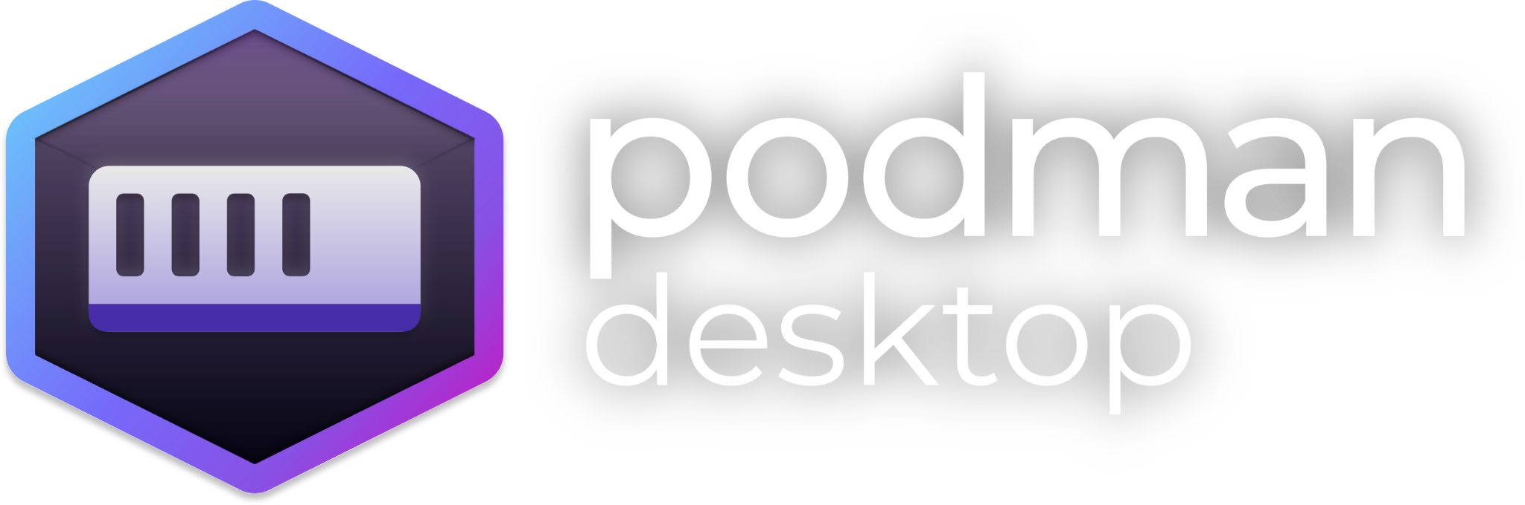
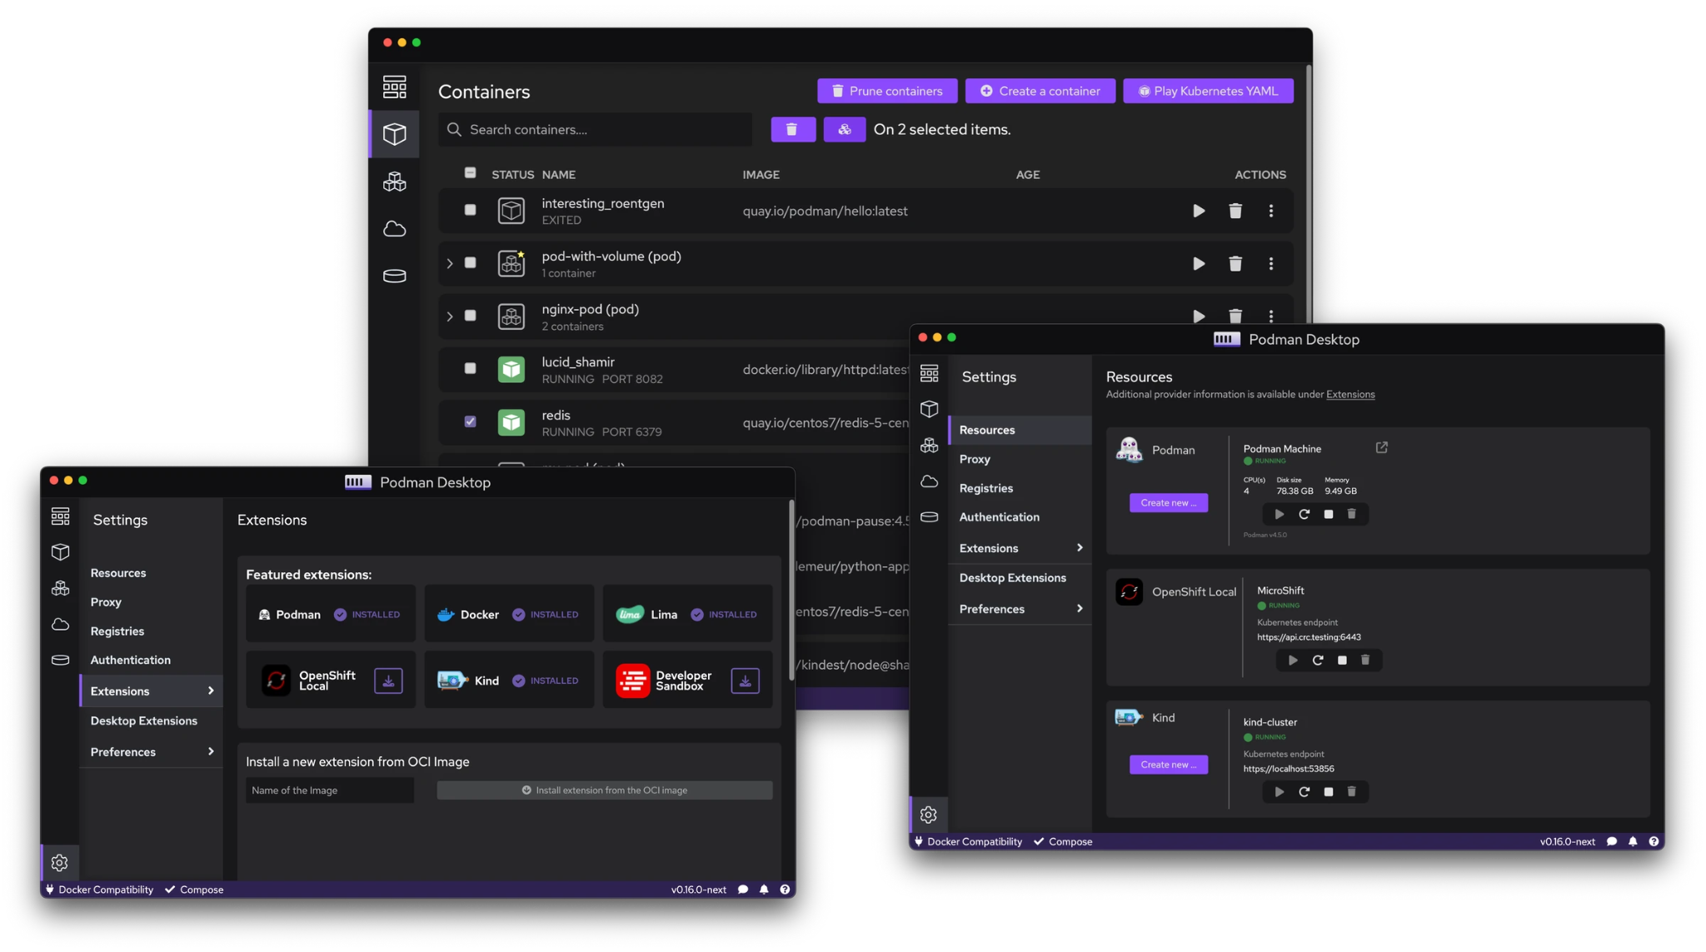




Containers and Kubernetes for application developers
Podman Desktop is an open source graphical tool enabling you to seamlessly work with containers and Kubernetes from your local environment.
Supported platforms:
podman-desktop.io
Notes:
Thank you Mario.
On top of Podman, there is Podman Desktop.
So if you’re like me and enjoy using a mouse and not Vim to edit files, then you’ve got to give Podman Desktop a try.
It manages the Podman engine for you, let’s you easily build and start containers, as well as instantly debug and enter the shell to troubleshoot, has great extensions and let’s you use your Kubeconfig to view your clusters and deploy directly to them!

Slide 2
Why use Podman-Desktop ?

Slide 3
What’s going on between local and prod environments?
Additional complexity
Exposed level of complexity and additional overhead required to go cloud native.
“Local developer environments have become impractical and lack of consistency with production.”
Skills Gap
Lack of skilled workforce and technological expertise. 70% IT departments have a single expert team on Kubernetes.
Devs & Ops disconnect
82% IT departments claim Kubernetes creates conflicts.

Slide 4


Challenges from local developer environments
to deployments on production
Moving from Local to Prod
LOCAL DEV ENV
KUBERNETES
Base Images: Docker Hub
Base Images
Low / No Security
Quay.IO
Inner Loop
Container Registry: Docker Hub
WALL OF DISCREPANCIES
Rootless
Docker Compose
Kubernetes YAML
DEVELOPMENT TEAM
No binding with Managed Services
Managed Services
OPS TEAM
Minikube
Reproducing “Prod workloads” environment in Local
Adoption Barrier
Ops are burdened by having to convert developers’ artifacts.
Notes:
Stevan
When we started building Podman Desktop, we looked at the usual challenges…
Developers: We can kind of illustrate this here with this flow of moving from local to production for application development and deployment, where developers like myself are working with standard base images from Docker Hub or wherever it may be, with security issues in their base images or dockerfiles, using Docker Compose which can be a dead end for translating my application to Kubernetes,
Operations: And on the other side, the Operations teams are working with carefully curated base images, transferring my application over and working with rootless containers by default, in the trenches with Kubernetes YAML and managed services, and this leads to a wall of discrepancies between both sides that we know as the adoption barrier to adopting and translating to cloud-native.

Slide 5
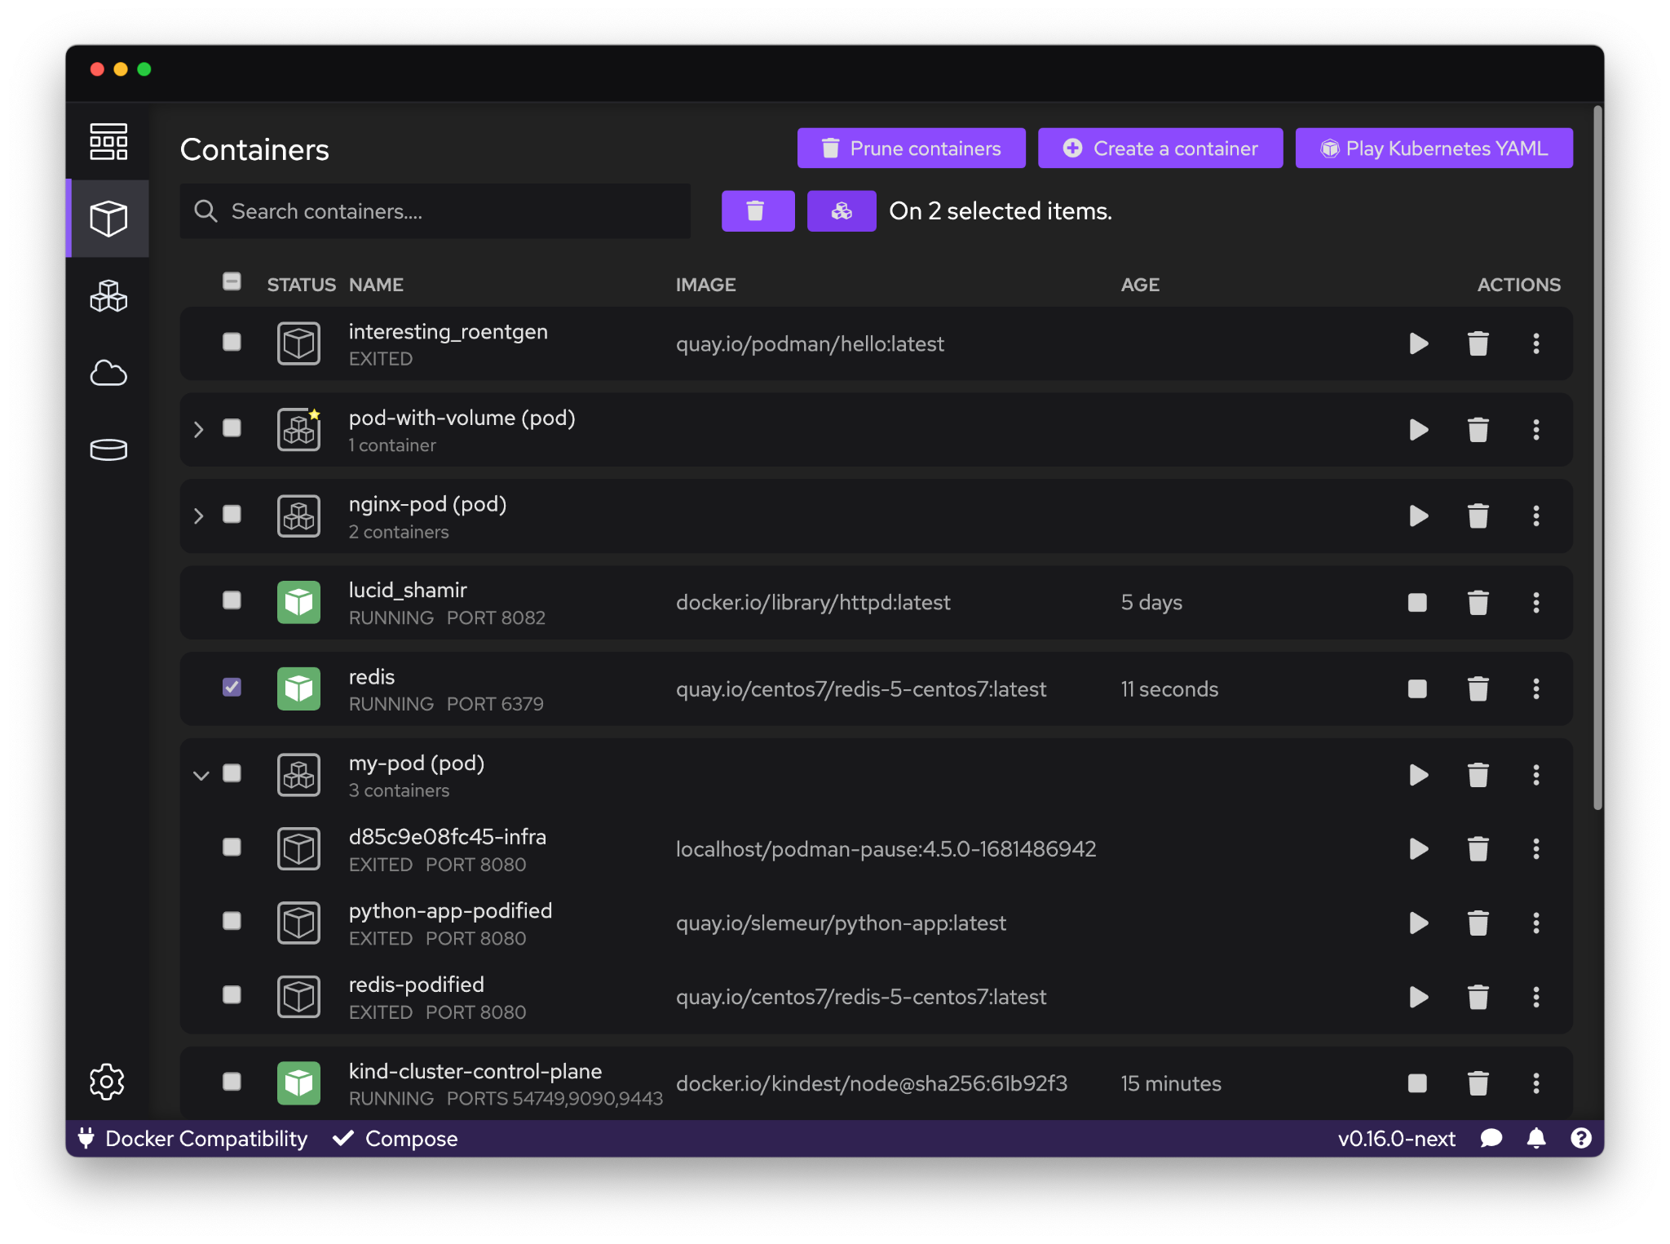
Introducing Podman Desktop
Containers and Kubernetes for Application Developers
Podman and Kubernetes
Install and run anywhere: Windows, Mac and Linux
Keep it up-to-date
Containers and Pods
Build, run, manage and debug Containers and Pods
Run Pods with or without Kubernetes
Manage multiple container Engines
Compatibility with Docker and Compose
Enterprise Readiness
VPN and Proxies configuration
Image registry management
AirGapped Installation
Bridge between local and remote
Connect and deploy to remote Kubernetes clusters
Enable remote managed services locally
Notes:
Welcome: So if you’re like me and enjoy using a mouse and not Vim to edit files, then you’ve got to give Podman Desktop a try. It manages the Podman engine for you, let’s you easily build and start containers, as well as instantly debug and enter the shell to troubleshoot, has great extensions and let’s you use your Kubeconfig to view your clusters and deploy directly to them!

Slide 6
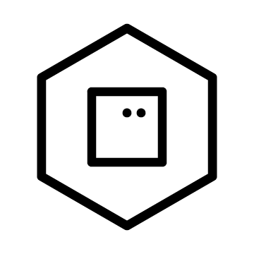

Simplistic onboarding.
From applications to containers, to pods, to Kubernetes.
Kubernetes Cluster
Docker-Compose
Ingress/Router
Pod
Pod
Pod
Container
Pod
Node
Node
Node
KInd / Minikube
Podman Engine
Kubernetes Remote and Managed Services
Notes:
Stevan
Idea: What we’re proposing with Podman Desktop is a way to simplify the workflow and application development process for containers and deployment to Kubernetes, to bring Kubernetes closer to developers, and minimize the discrepancies between local and prod environments. So today, we’ll be going from source code, to containers, to a local kubernetes cluster, and finally to a remote cluster to share our application with the world.
Old Notes:
Podman Desktop simplify workflows and experiences working with containers when targeting production on Kubernetes / OpenShift by:
Bringing Kubernetes / OpenShift closer to the developer
Minimizing the discrepancies between the desktop and target Kubernetes environments.
Podman Desktop aims to bridge the gaps between developer environments and targeted production environments.
Enabling a simplistic onboarding, to let the developers go from applications to containers, to pods and to Kubernetes.
Podman desktop can usher an application through the developer pipeline
They can start as containers
Be translated into pods natively in podman
Be translated to a kubernetes pod
This can be tested in dev sandbox or a simulated kubernetes environment
That pod can be easily adapted for production in openshift

Slide 7
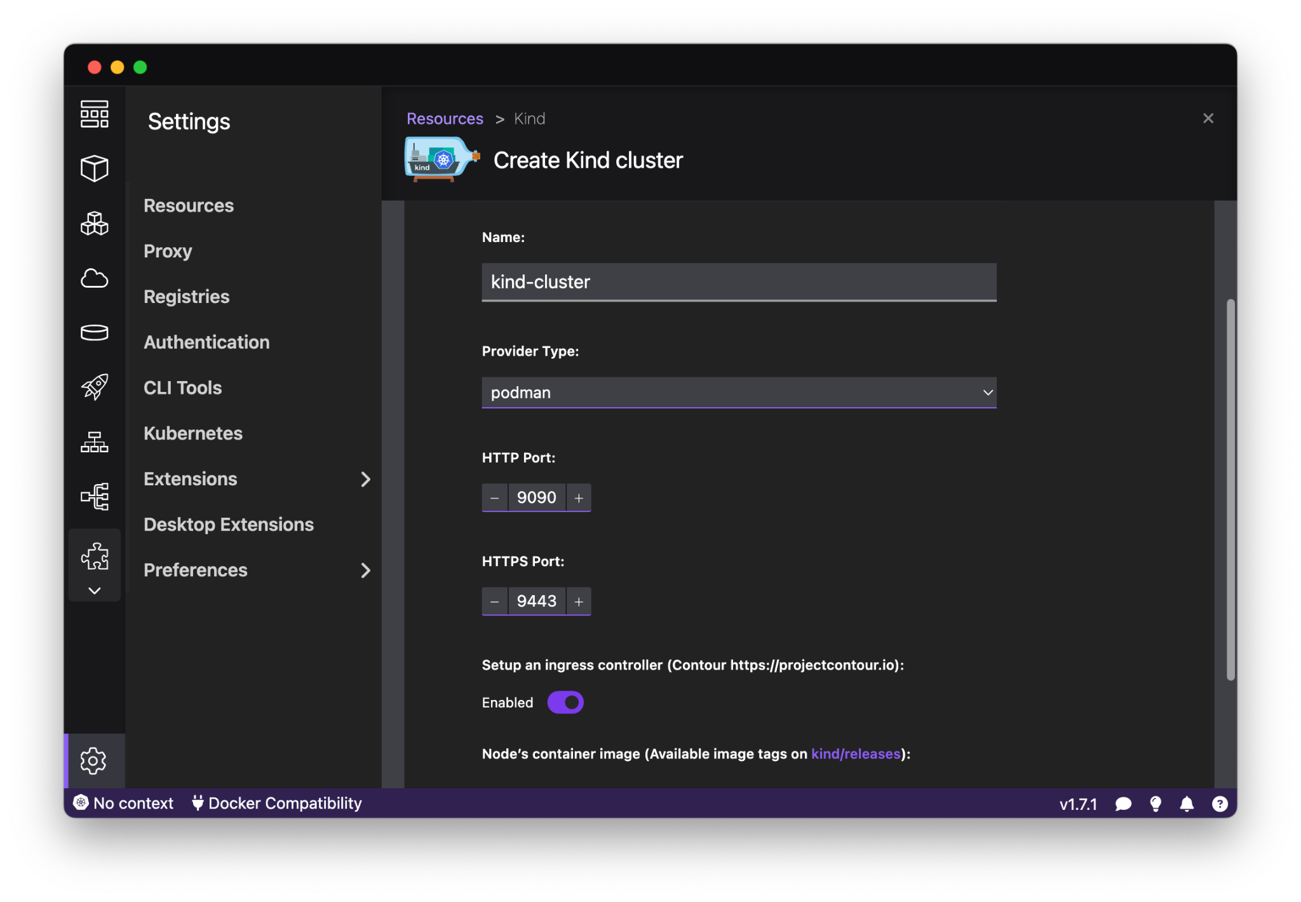
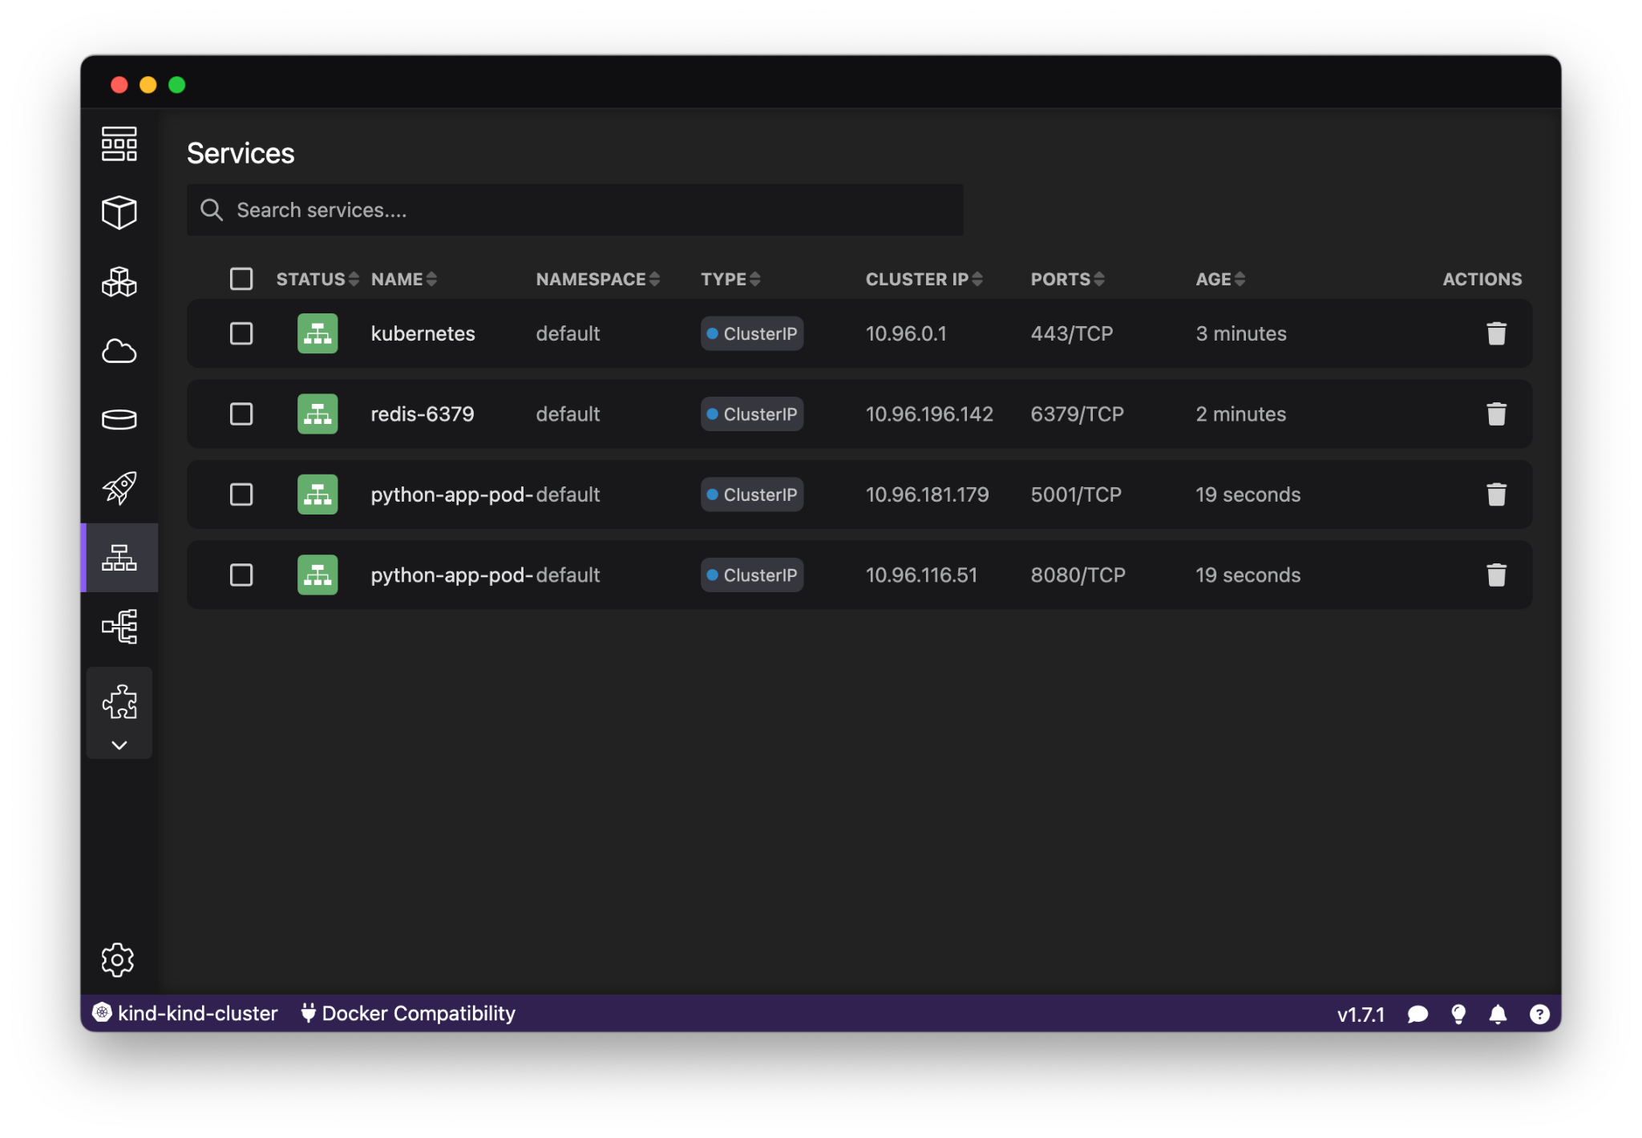
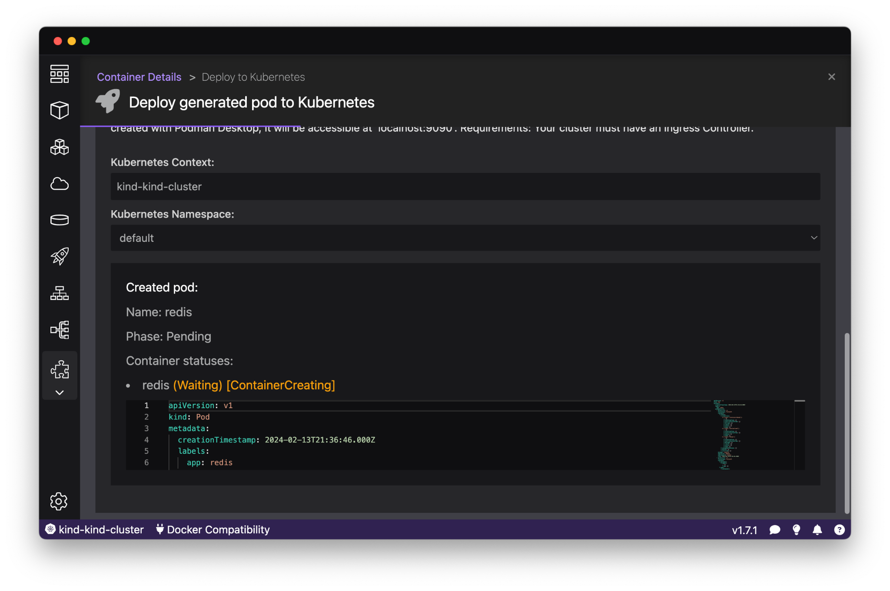
Podman Desktop: Kubernetes Integration
Easily move from containers to Kubernetes through the Kubernetes UI for Deployments, Services, and Ingress & Routes
Create local Kubernetes clusters using Kind or Minikube for local development and testing
Easily push images from Podman Desktop to your clusters
View and select your current Kubernetes context in the Podman Desktop tray for deployment
Automatically expose services locally & create routes to your applications (with OpenShift)

Slide 8
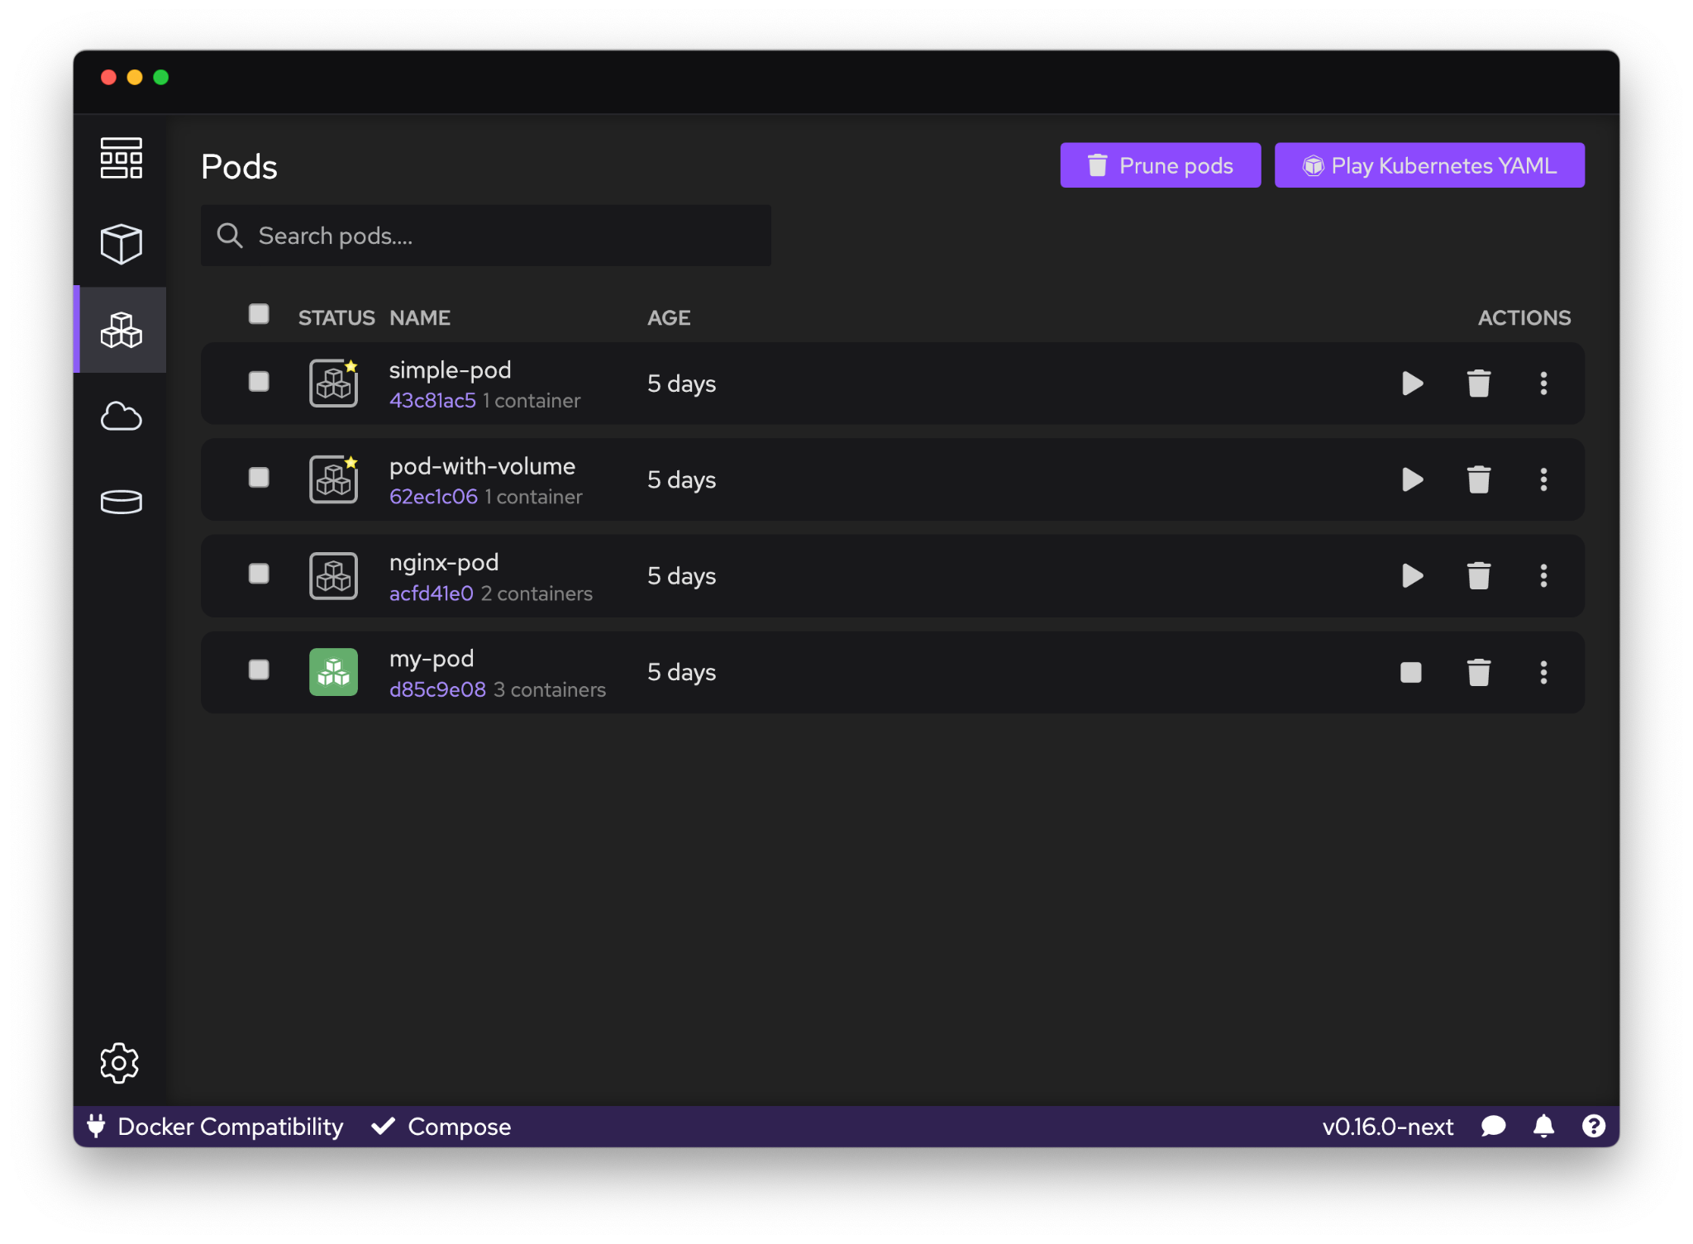
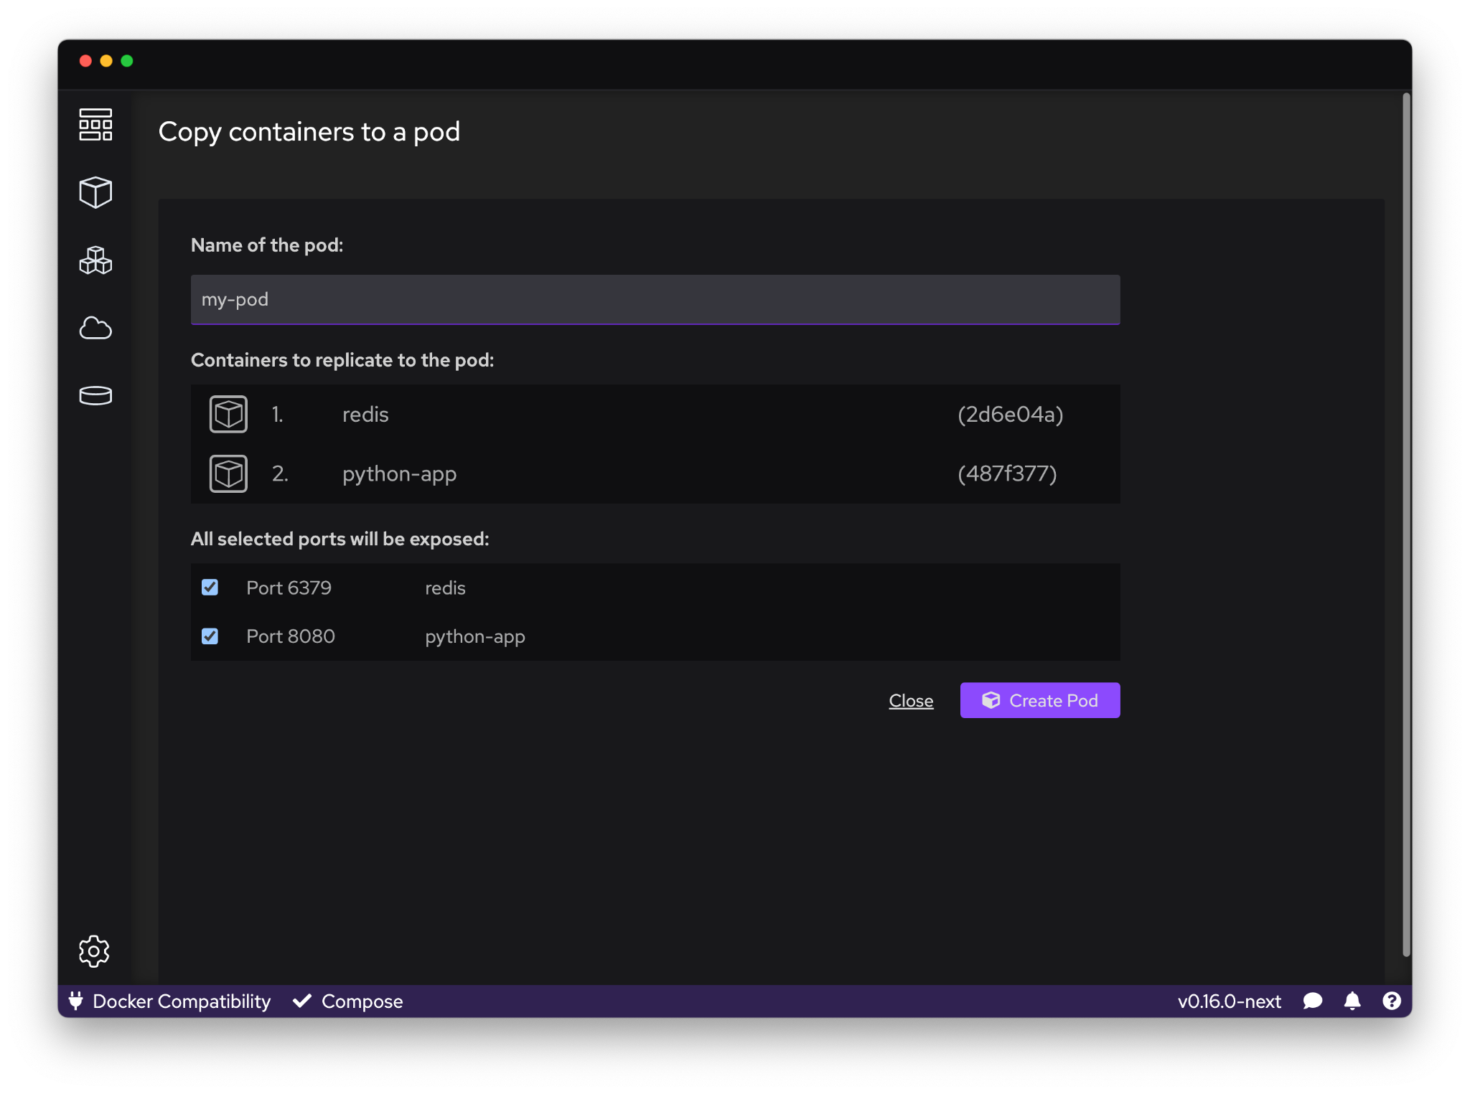
Podman Kube Capabilities
Create and start Pods with Podman
Select containers to run as a Pod
Play Kubernetes YAML locally without Kubernetes
Generate Kubernetes YAML from Pods

Slide 9
Free, Open and Extensible
-
By Default

Slide 10
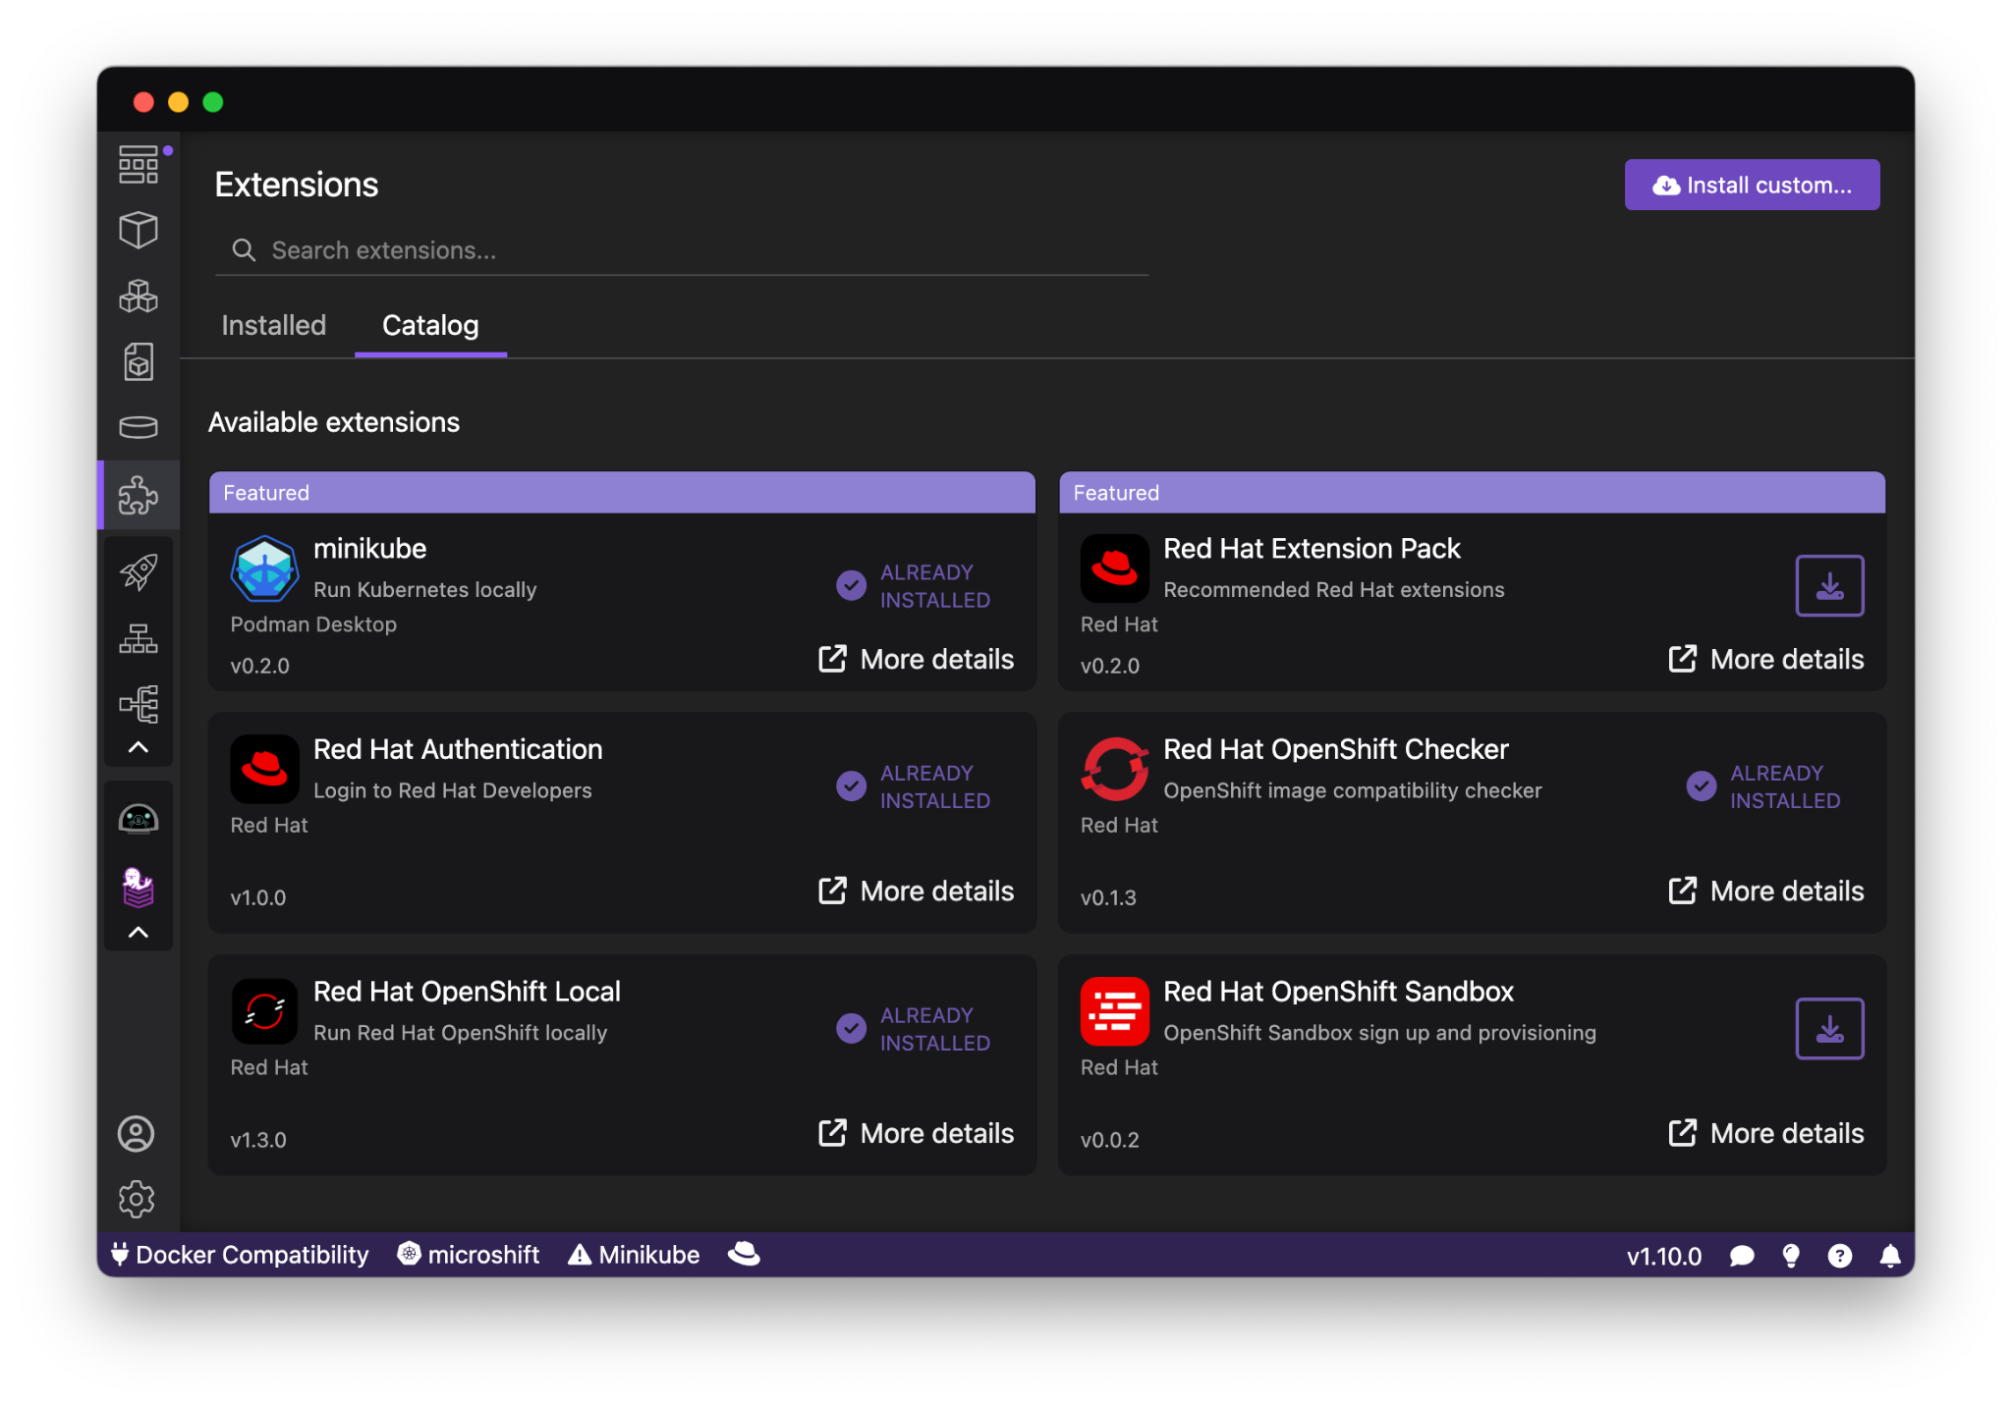
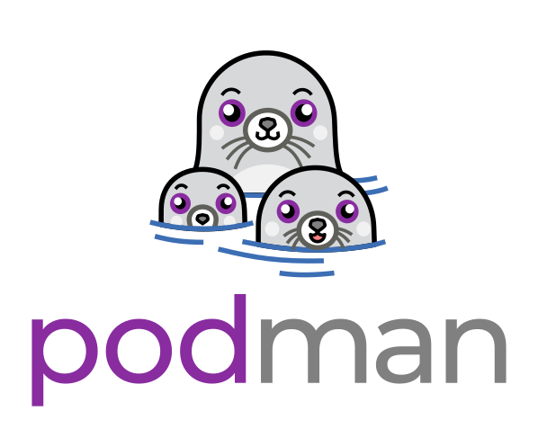
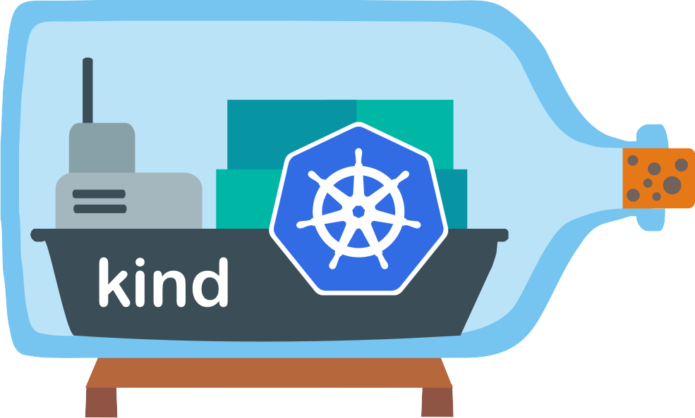



Extensibility with Podman Desktop
Enabling extension points and other container/K8s technologies
But Podman Desktop extensions can also do much more:
Container engine providers
Kubernetes providers
Add actions
Add menus
Add configuration
Add default registries
Add to status bar
Add to system tray
Supports Docker Desktop extensions
Current
extensions:
& more!
Podman
Kind
Lima
Docker
OpenShift Local
Notes:
Extensibility: One of the best parts about Podman Desktop is enabling developers and the community to use it as a platform for whatever your use case may be! For example, a community member helped to create the Minikube extension, there’s tons of PR’s waiting to be reviewed for other features, and you can even use existing Docker Desktop extensions within Podman Desktop. It’s all really a testament to the power of open source development, which is great

Slide 11

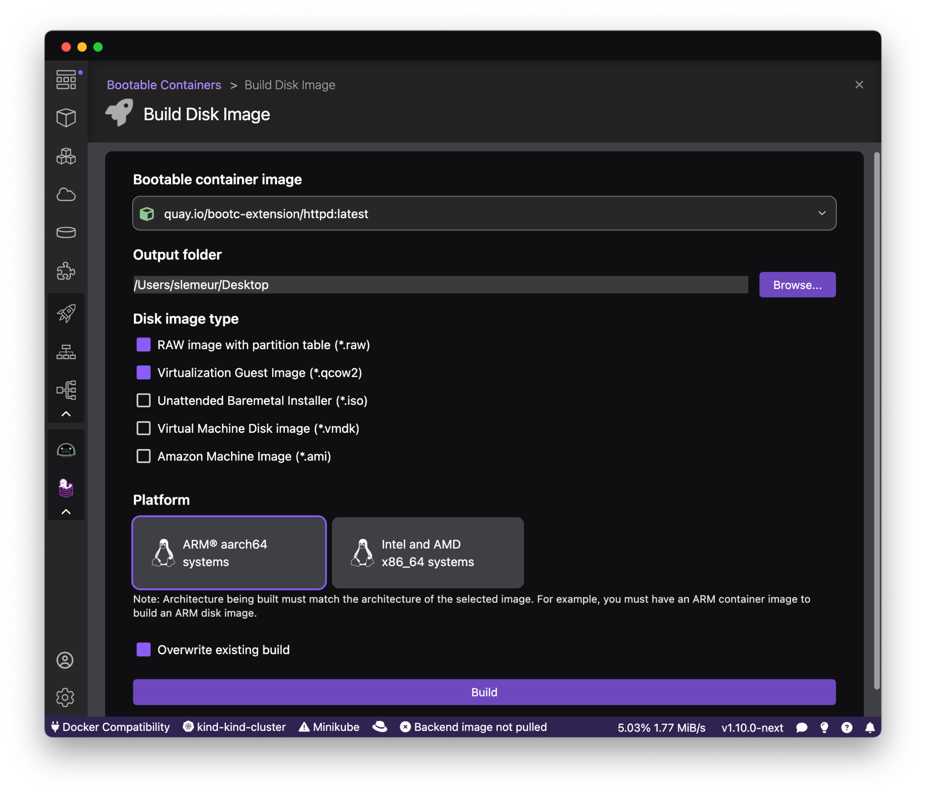
Bootc (Bootable Containers) Extension
Container workflows now drive the operating system
Create bootable container images for bare metal to AWS and everywhere in between
Build for Intel & Arm architectures
Easily add drivers, frameworks, or runtime libraries needed for acceleration.
qcow2 | QEMU Disk Images
ami | Amazon Machine Images
raw | Raw disk image with MBR or GPT partition table
iso | Unattended installation method (USB Sticks / Install-on-boot)
vmdk | Virtual Machine Disk Image

Slide 12
Bootc Extension Demo < Placeholder>

Slide 13
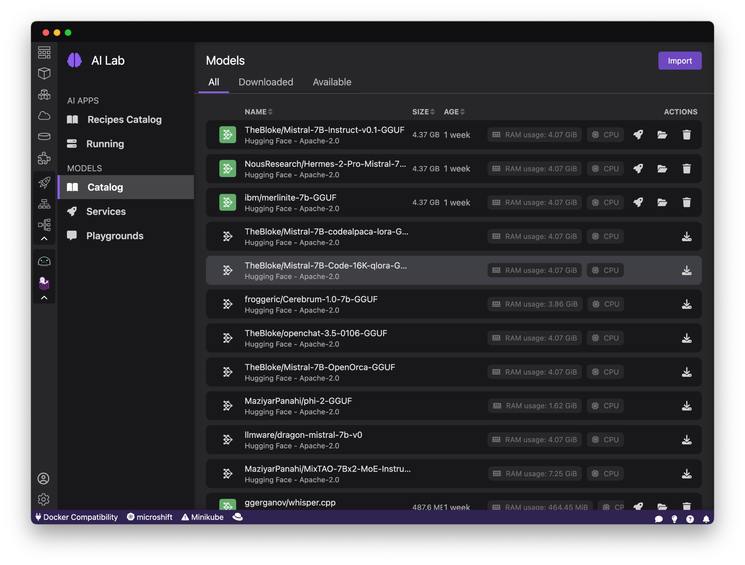
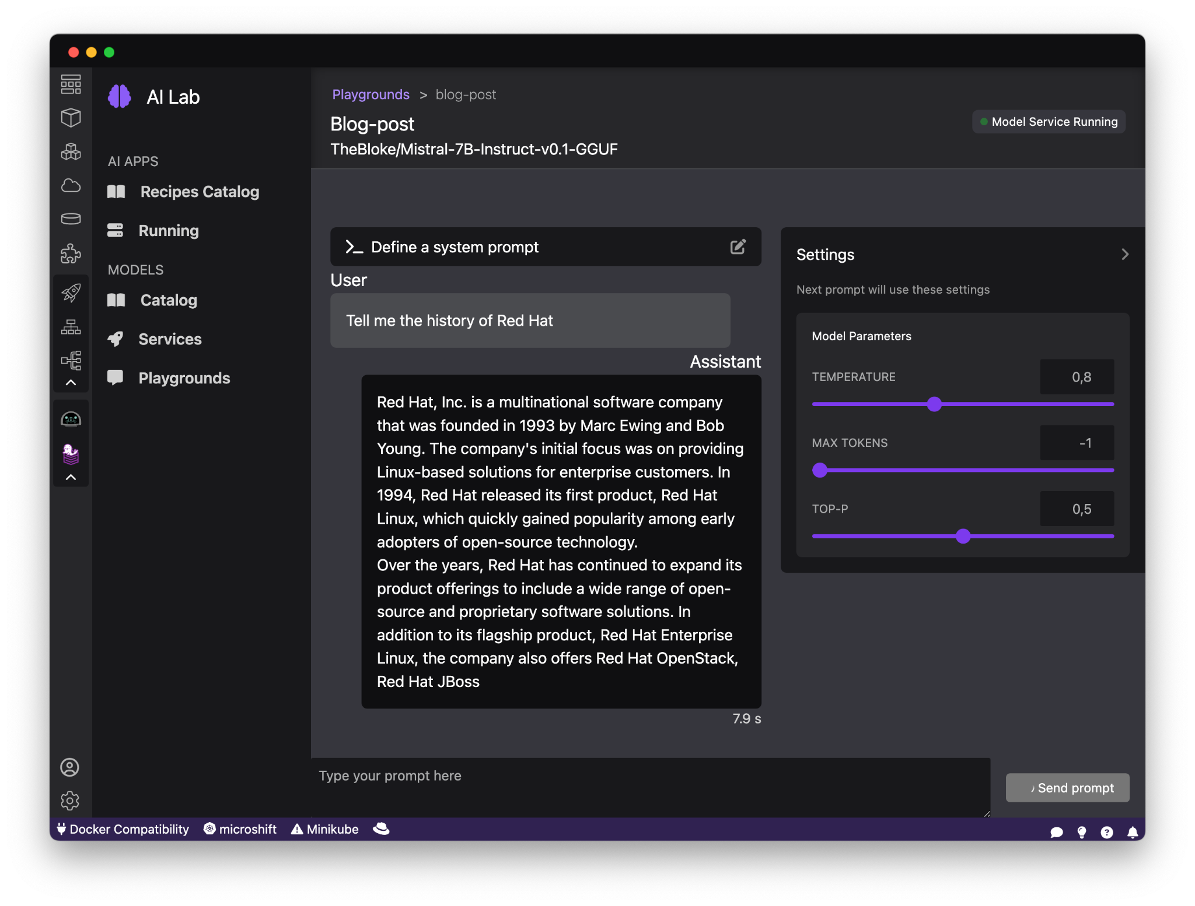
Podman AI Lab Extension
Your developer environment for working with GenAI
Discover Gen AI
Get inspired by AI use cases
Learn how to integrate AI in an optimal way
Experiment with different compatible Models
Model Catalogs
Leverage a curated list of open source large language models available out of the box
Import your own models
Run Models Locally
Run models with an inference server running in UBI image
Get OpenAI compatible API
Use code snippets
Playground Environment
Experiment with models and prompts
Configure settings and system prompts
Test and validate prompt workflows before using in your application

Slide 14
AI Lab Extension Demo < Placeholder>

Slide 15
Build your own
Podman Desktop Extension …

Slide 16
How has
Podman Desktop helped you??
<Use Case Placeholder>

Slide 17
Podman Desktop Part of CNCF

Slide 18
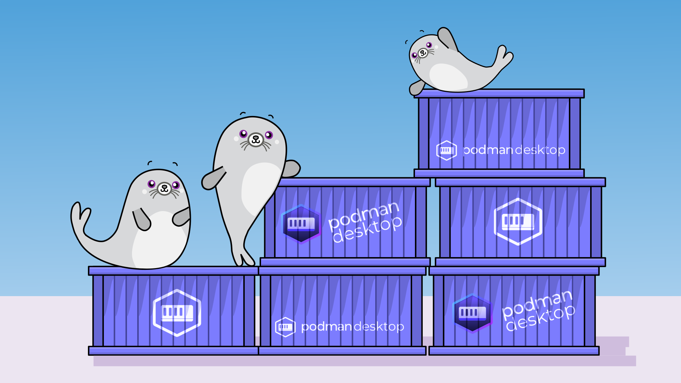

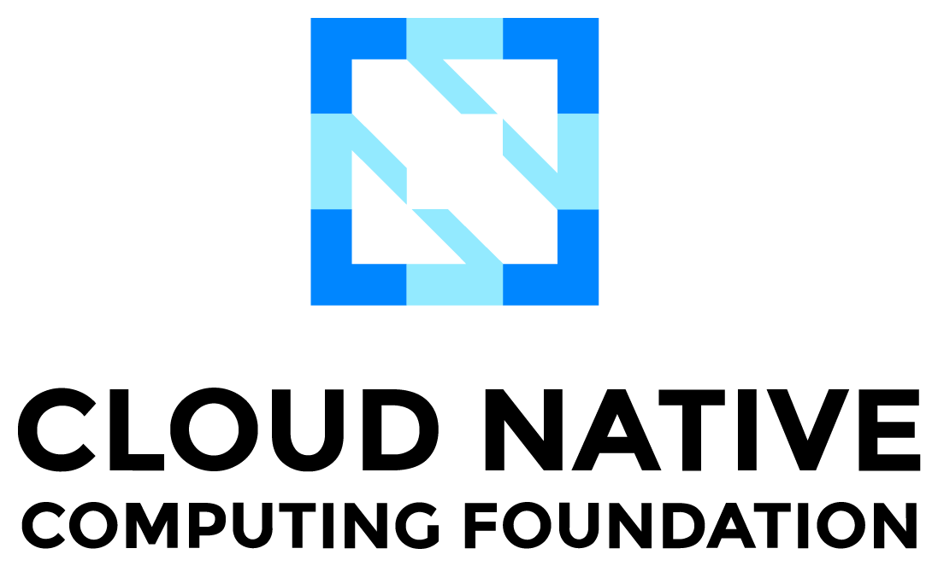
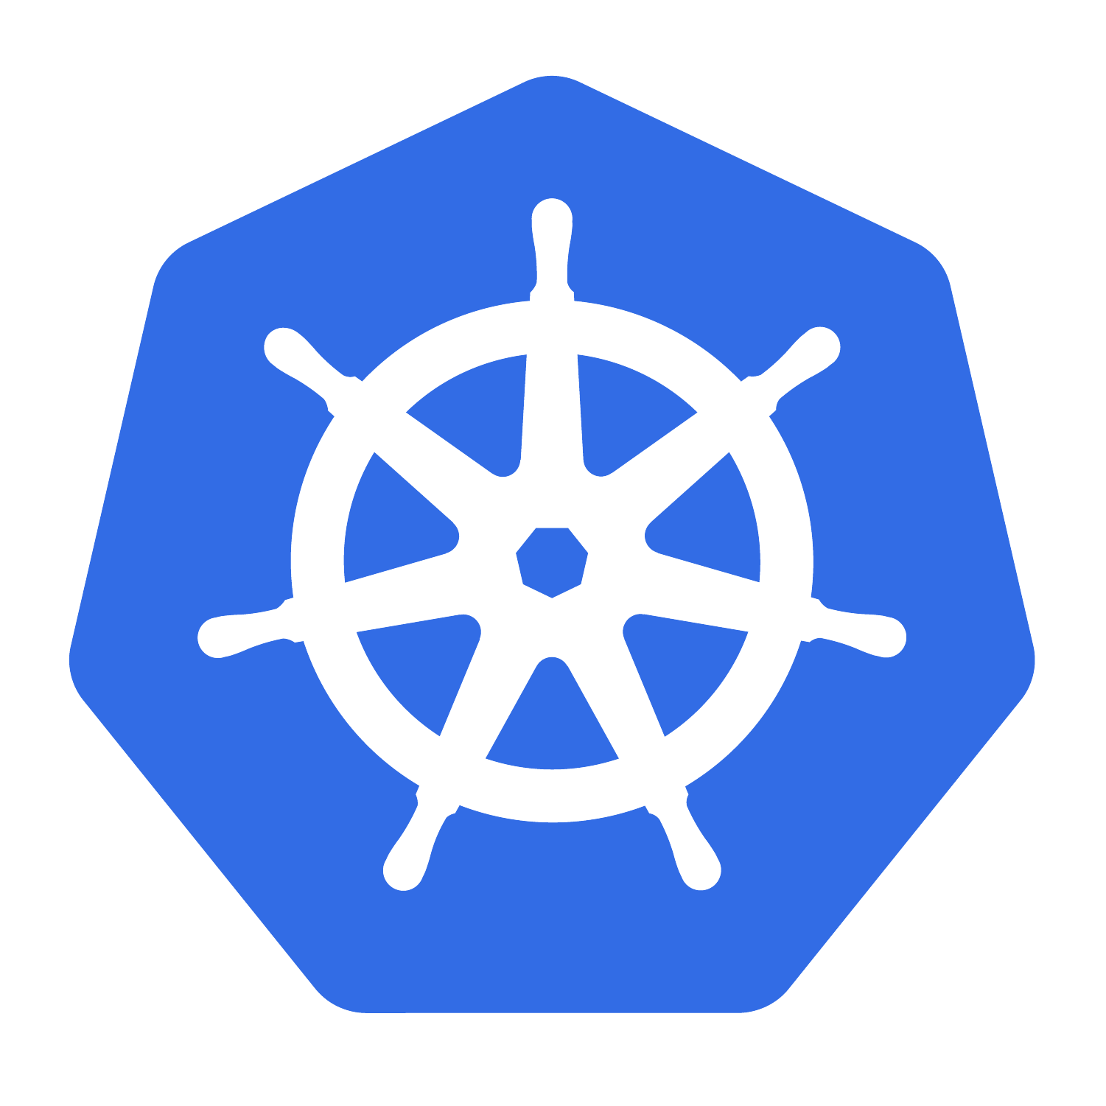
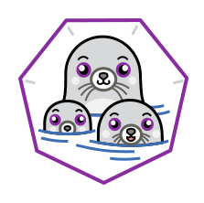
Notes:
Those little seals, they are fan of kubernetes of course - and you probably heard that Podman, along with Podman Desktop are being submitted for contribution at the sandbox level for becoming CNCF projects.

Slide 19
Contributing
Notes:
python3 -m flask run

Slide 20




Get started with Podman & Podman Desktop!
Get involved with Podman and adopt a seal (figuratively)!
On the Web
Github
Chat
Learn how to install Podman
podman.io
podman-desktop.io
Contribute and report issues
github.com/containers/podman
github.com/podman-desktop/podman-desktop
Get connected with the community
podman.io/community
Source:
https://developers.redhat.com/e-books/podman-action

Slide 21
Thank You !

